Slide 1
Customer Churn Prediction and Retention Strategy
Prepared by: Afinu Mansoor NK
Tools Used: Python, Pandas, Matplotlib, Seaborn, Scikit-learn Dataset: Telco Customer Churn (Kaggle)

Slide 2
Business Problem
A large telecom company experiencing high customer churn (around 25% annually). Losing customers directly impacts revenue, and senior management is under pressure to reduce churn. They want a predictive system to identify customers most at risk of leaving so the retention team can proactively intervene. They also want actionable recommendations on how to retain these customers, including example personalized communication strategies they can deploy.
Objective:
• Clean and preprocess customer data (demographics, tenure, billing, complaints). • Perform EDA to uncover key churn drivers with clear visuals.
• Build and evaluate a classification model to predict churn risk.
• Analyze feature importance to identify actionable insights.
• Propose retention strategies with example personalized messages.

Slide 3
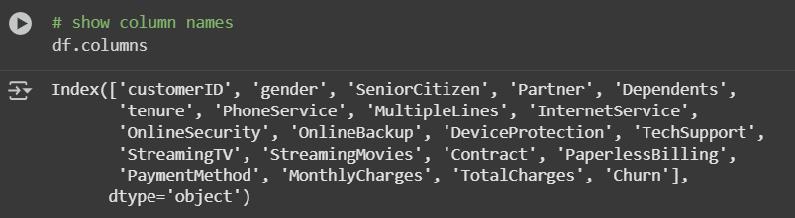
Dataset Overview
Source: Kaggle – Telco Customer Churn Dataset
Total Records: 7,043 customers
Target Variable: Churn (Yes/No)
Feature Categories:
Demographics: Gender, Senior Citizen, Partner, Dependents
Account Info: Tenure, Contract Type, Payment Method
Services: Internet Service, Tech Support, Streaming TV, etc.
Billing: Monthly Charges, Total Charges

Slide 4
Data Profiling
df.head() / df.tail() / df.sample() – to understand sample records.
df.shape – dataset size.
df.columns – all feature names.
df.dtypes – to identify data types (noticed “TotalCharges” as object).
df.info() – overall summary with non-null values.
df.nunique(), df.count() – to check unique entries and completeness.
df.describe() – basic statistical summary.
df.duplicated().sum() – checked and found no duplicates.
df.isnull().sum() – found missing values in TotalCharges.
IQR method – Outlier check done, only SeniorCitizen flagged but invalid since binary

Slide 5
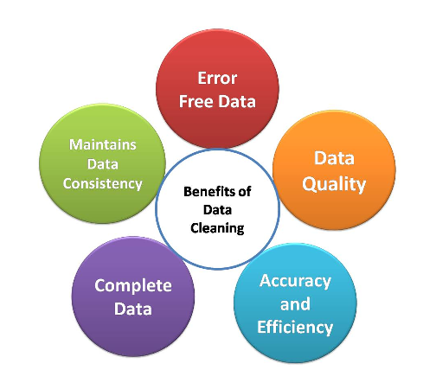
Data Cleaning & Preprocessing
Removed extra spaces in column names.
Converted TotalCharges from object → float (missing values replaced with 0).
Verified no duplicates.
Encoded categorical columns using One-Hot Encoding.
Added Tenure Buckets to group customers.
Scaled numeric columns (tenure, MonthlyCharges, TotalCharges) using StandardScaler for model consistency.

Slide 6
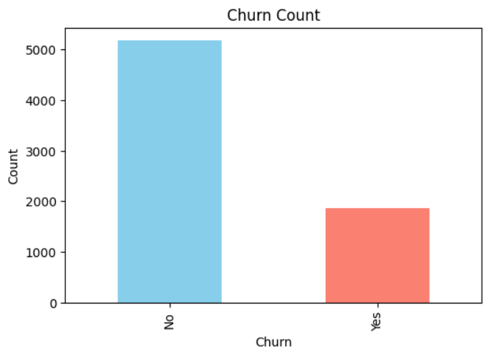
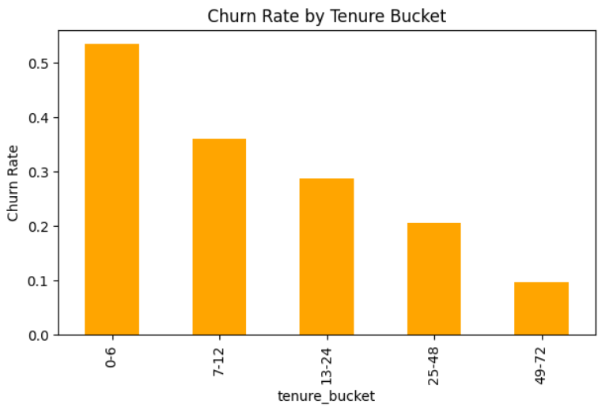
Exploratory Data Analysis (EDA)
Customers with short tenure (0–6 months, 7–12 months) show higher churn proportion than long-tenure customers.
26.5% customers churned.

Slide 7
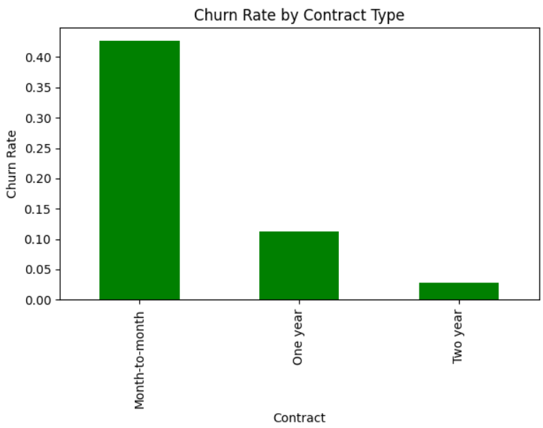
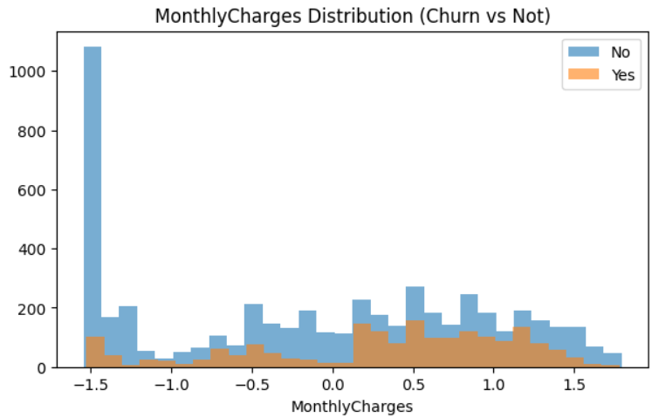
Contract Type: Month-to-month customers have highest churn.
Monthly Charges: Higher charges → higher churn tendency.

Slide 8
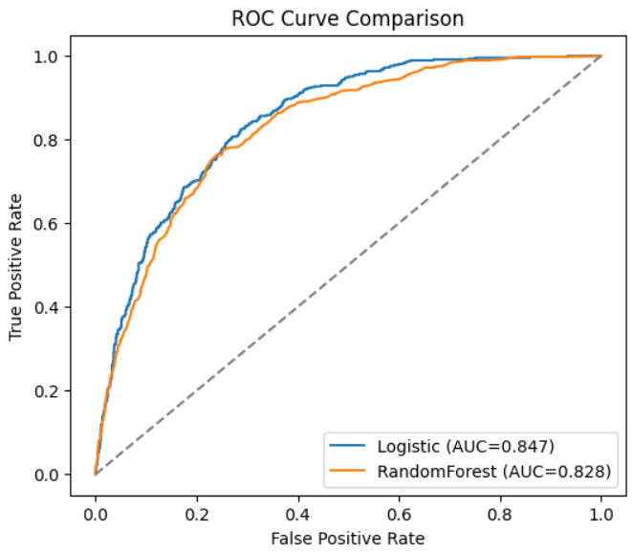
Model Building and Evaluation
Algorithms Used: Logistic Regression, Random Forest
Data Split: 80% training / 20% testing
Logistic Regression:
Accuracy: 0.8075
ROC AUC: 0.8467
Random Forest:
Accuracy: 0.7888
ROC AUC: 0.8284
Logistic Regression performed slightly better and easier to interpret.

Slide 9
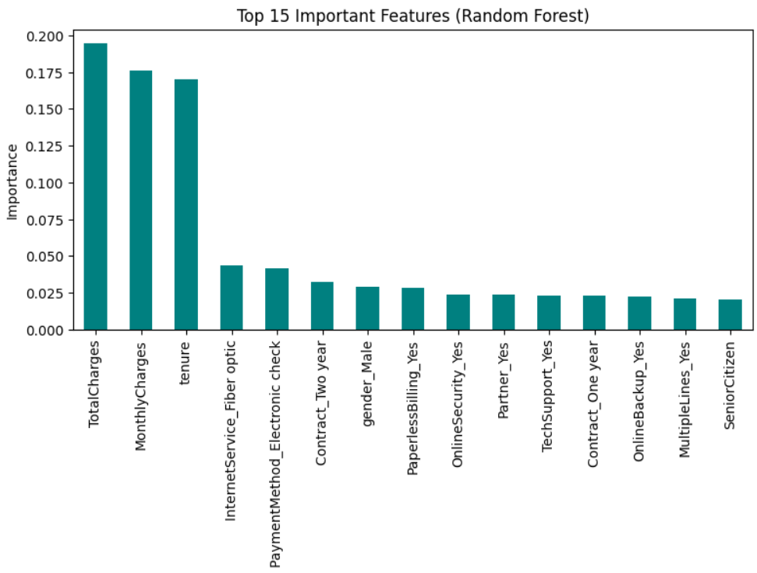
Feature Importance Analysis
The top predictors of churn identified by the model:
Contract Type
Tenure
Monthly Charges
Payment Method
Internet Service

Slide 10
Key Insights & Retention Strategy
Insights:
Senior citizens and month-to-month customers churn more.
Higher monthly charges and lower tenure are risk factors.
Retention Strategy:
Offer loyalty discounts or long-term plans to customers with short tenure.
Reduce billing surprises for high 'MonthlyCharges' customers through flexible plans.
Provide special care for customers with multiple complaints or service issues.
Improve customer service for 'Fiber optic' and 'Internet' service users (common churn reasons).
Send personalized retention messages to at-risk customers.
Example message:
For high-risk customer (short tenure, high charge):
"Hi, we noticed you’ve been with us for a few months. To thank you, we’re offering a 20% discount on your next bill!"
For long-term customer showing churn signals:
"Thank you for being a loyal customer! We’d love to keep you with us. Here’s a free upgrade to our new high-speed plan."
For complaint-heavy users:
"We’re sorry for your past issues. Your feedback matters .we’re assigning you a dedicated support manager to ensure everything runs smoothly."

Slide 11
Conclusion & Future Work
Conclusion
Successfully built a churn prediction model with ~80% accuracy.
Logistic Regression is preferred due to better interpretability.
Helps companies identify high-risk customers early.
Future work
Use real-time data and advanced models.
Deploy model using Streamlit or Flask.

